Slide 1
I-Connect Student Training

Slide 2
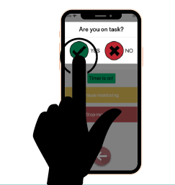
What is I-Connect?
An app that helps you to stay on task
A notification will pop up every few minutes to ask you if you are on-task.
The notification helps you to recognize if you are on-task or if you need to refocus your attention on your work.

Slide 3
How can I-Connect Help You?
Get more work done
Be more accurate
Work quietly/without distracting others
Other

Slide 4
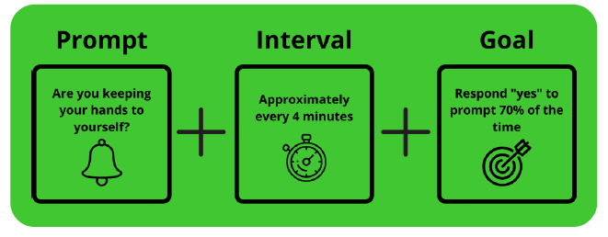
How will you use I-Connect?
Are you on task?

Slide 5
Using I-Connect
Open the app on your computer/tablet
Login with your user name
Select the location you will monitor in
When you are ready, press start
When the notification pops up check YES if you are on-task and NO if you need to get back on-task.
Pause monitoring if you have to leave the classroom or your workspace for a bit.
Stop monitoring when your work is done.
You can check the chart at the end of the session to see if you met your goal.

Slide 6
Checking YES When You are On Task
Check yes only if you are on-task when the notification pops up.
You won’t get in trouble if you check “no” - it’s just a reminder for you to get back on task if you are distracted.
Let’s Practice…
Log in to the app and star monitoring
Being on-task looks like…
Being off-task looks like…

